Slide 1

The Importance of Architecture for Achieving Human-level AI
John Laird
University of Michigan
June 17, 2005
25th Soar Workshop
laird@umich.edu
Notes:
Winston – too much emphasis on architecture on problem solving, not enough on language and vision

Slide 2
Requirements for Human-Level AI
Behave flexibly as a function of the environment
Exhibit adaptive (rational, goal-oriented) behavior
Operate in real time
Operate in a rich, complex, detailed environment
  Perceive an immense amount of changing detail
  Use vast amounts of knowledge
  Control a motor system of many degrees of freedom
Use symbols and abstractions
Use language, both natural and artificial
Learn from the environment and from experience
Live autonomously within a social community
Exhibit self-awareness and a sense of self
All of these can apply to almost any task
(Adapted from Newell, Rosenbloom, Laird, 1989)
Notes:
Many ways to define human-level behavior –
My preference is as a set of requirements that are mostly qualitative properties of behavior and its relation to environment
More than just rational
Key observation is that these can apply to any task – system doesn’t get to choose – it must be “prepared”
Given that is our goal – what is a strategy for achieving it?
Our approach is to concentrate on the underlying structure that leads to the required functionality.
It is clear that the underlying processing mechanisms, memories, and learning mechanism will be critical to achieve this.

Slide 3
Human-level AI
Knowledge
Goals
Architecture = Structure
Fixed mechanisms underlying cognition
  Memories, processing elements, control
Purpose:
  Bring all relevant knowledge to bear in select actions to achieve goals
Examples:
  Soar, ACT-R, EPIC, ICARUS, 3T, CLARION, dMARS, CAPS, …
Architecture
Body
Task Environment
Notes:
Go through components –
Behavior = Knowledge, Goals, Architecture, Task Environment
Goal: instantly bring all available knowledge to bear to select actions to achieve goals.
Learning is implicit in “all relevant knowledge”
The perfect architecture:
Disappears so that only the task environment, knowledge, goals determine behavior.
Challenge is that architectures aren’t perfect
Large gap between competence and performance

Slide 4
Generic Architecture
Long-Term Memories
Procedural/Skill
Semantic/Concept
Episodic
Rule Learning
Semantic
Learning
Episodic
Learning
Short-Term Memory
Control Procedure
Perception
Action
Body
Notes:
Instead of organizing by subarea of knowledge – language, driving, etc.
Organize by computational primitives.

Slide 5
Why Architecture Matters
Architecture determines:
  The complexity profile of an agent’s computations
  The primitive units of reasoning/deliberation
  The primitive units of knowledge
  What is fixed and unchanging vs. what is programmed/learned
Architecture provides:
  The building blocks for creating a complete agent
  A framework for integrating multiple capabilities
Architecture is an attempt to capture/formalize regularities
  Forces the theorist to be consistent across tasks
Notes:
A commitment to computational primitives
Some might argue that the underlying architecture doesn’t matter – whether your program runs on a PowerPC or a Pentium doesn’t really matter. That is because there are many levels of interpretation (billions of instructions) between the behavior of your agent and that level of architecture. For these architecture, there isn’t that much distance – the knowledge is task knowledge, not knowledge about managing memory, displaying pixels on the screen.
What is sequential, what is parallel
What requires constant time, linear time, log time, …
Primitive unit – what is atomic, not interruptible -
Primitive unit = 50 msec.
What is primitive unit of knowledge – what gets learned,
What can be learned, how is it integrated in with existing knowledge
Types of knowledge access (procedural, declarative, …)

Slide 6
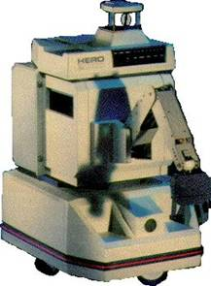
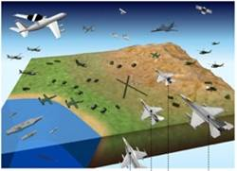
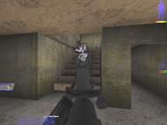
Architecture-based Research
Pick subset of desired capabilities, performance, and behavior
Analyze computational requirements
Design and implement architecture
Build a variety of agents that stress capabilities
Evaluate agents and architecture
Expand desired set of capabilities, performance, behaviors
Towers of Hanoi
R1-Soar
Hero-Soar
TacAir-Soar & RWA-Soar
Soar MOUTbot
Notes:
Interleave these steps.
Is capability architecture or knowledge

Slide 7
Utility of a Research Strategy?
Efficient at achieving research goal
Focuses research on critical issues
Supports incremental progress, results, and evaluation
Notes:
Theoretical arguments and evidence from past experience with architecture research

Slide 8
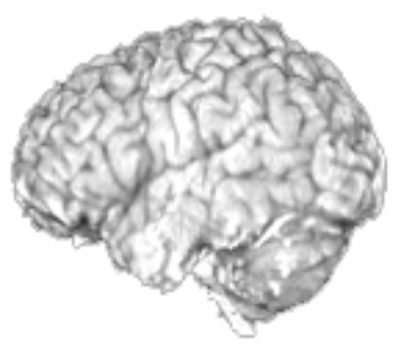
Efficient at Achieving Research Goal
Supports parallel exploration of solution space
  Alternative architectures
  Research can be decomposed into architecture and knowledge
Integrates research results from all available sources
  Applications, AI, psychology, neuro-science
Supports accumulation of results
  New architectural components are shared by all capabilities
  Constraints derived from one capability transfer to other areas providing a starting point for new tasks/capabilities
  Architecture invariants propagate to all architectures
0.4
Parietal: r = .955
Day 1
Parietal/Imaginal: BA 39/40
[ACT-R Problem State]
Day 5
Day 1
0.3
Day 5
3x-5=7
0.2
Percent Change in Bold
Response
0.1
0.0
0
3
6
9
12
15
18
21
-0.1
John R. Anderson, Carnegie Mellon University
Time during Trial (sec.)
Notes:
Explorations
Many architectures
Within an “architectural group” decomposition between architecture developers and capability developers – NL-Soar
Combines results from many sources:
Try to take “functional” requirements from neuro-science
Accumulation
Episodic memory
[ACT-R, SET]
Seeing a coming together of Soar, ACT-R, EPIC – 50 msec.
[I can tell the difference – and they mean a lot to me, but from a distance, they look very similar]

Slide 9
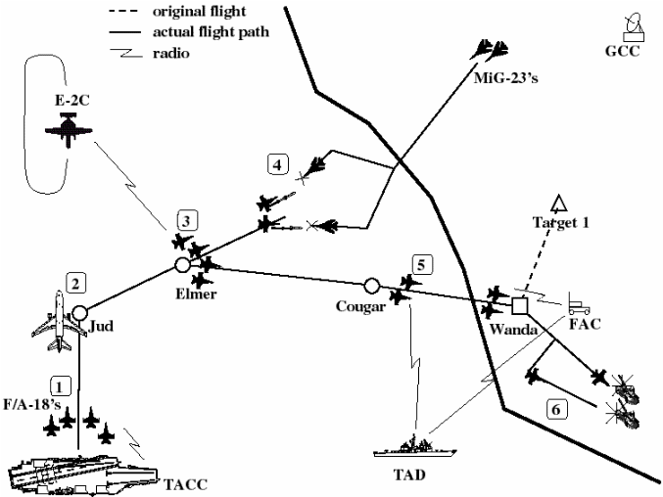
Focuses Research on Critical Issues:
Creating Complete Agents
Coarse-grain integration
  Connecting all capabilities, from perception to action
Fine-grain integration of capabilities/knowledge
  Dynamic intermixing of perception, situational assessment, planning, language, reaction, …
Ubiquitous learning that
  is not deliberately cared for and controlled
  is incremental and real-time
  doesn’t interfere with reasoning
  impacts everything an agent does
Long-term existence
  Scaling to tasks employing large bodies of knowledge
  Behave for hours or days, not minutes
  Generation of goals, drives, internal rewards, …
Notes:
Can’t be done if look at components in isolation
Hypothesis: Common task requirements underlie all behavior
Brings out constraints that are often missing when look at things in isolation
Can’t leave these to the end and try to patch the system up.
Examples: All recent Soar systems, starting with controlling a hero robot, SGI flight simulator.
Merger of NL-Soar and TacAir-Soar – still with interruptability
Complex AI systems that interact with environments for hours, not minutes

Slide 10
Supports Incremental
Progress, Results, and Evaluation
Has useful intermediate results
  Can build useful end-to-end systems today, even if approximations to human-level intelligence
Supports evaluation of incremental progress
  Capabilities of agents developed with architecture
    Ability to meet requirements for human-level behavior
  Separates architecture from knowledge, goals, environment
    Amount of knowledge required to achieve a level of performance
    Competence on complete tasks with given knowledge
    Breadth of knowledge that can be encoded/used
    Breadth and difficulty of goals that can be attempted
  Comparison to human behavior
    Match behavior, reaction time, error rates, …
Notes:
Beat on connectionist and neuro-science here.

Slide 11
Concluding Remarks
Notes:
What does it mean to develop a theory of human-level AI – it means discovering regularities that underlie cognition – invariants that exist across tasks and subtasks. Architectures are an attempt to codify the structures that give rise to those invariants – letting us explore their implications and interactions. Without architecture, it is all to easy to wave your hand and use different structures for different problems – ones that never fit together. That is one reason that ACT-R’s approach makes me a bit queasy and argues for “strong architecture”.
The only way to achieve human-level artificial intelligence is to try to build such systems. Not by building components, but by building complete human-level AI. To be successful, it should be informed by constraints from AI, psychology, and neuro-science. And that is the architecture strategy.

